Slide 1
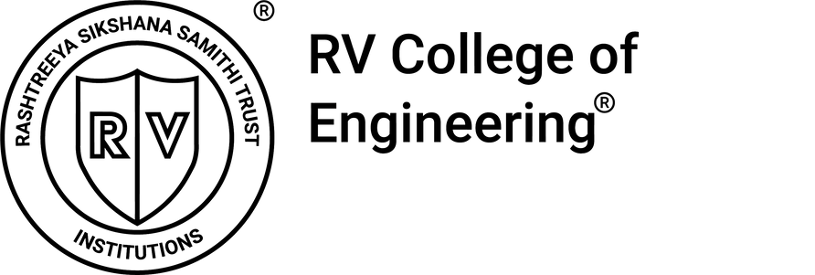

Machine Learning Operations
Case Study
Explain how inconsistent Python/library versions can change the behavior of the ML model. What production-readiness steps should the team follow to ensure environment consistency?
Team Members:
1RV23AI006 Adithya Acharya U
1RV23AI007 Aditya Kaushik
1RV23AI040 Joseph Rejo Mathew
1RV23AI058 Monil Palak Mehta

Slide 2
Why Versions Change Model Behavior
Machine-learning models are deeply tied to the environment that trains and runs them.
Libraries like NumPy, pandas, SciPy, PyTorch, XGBoost rely on C/C++ numerical backends.
Version updates change random number generation, floating-point math, and optimization algorithms.
Default behaviors in encoders, scaling, and missing value handling may differ across releases.
Python version upgrades trigger automatic dependency jumps that impact behavior.
Even minor variations lead to different predictions, especially in non-linear or deep learning models.

Slide 3
What Can Go Wrong
When development and production environments differ, the impact is real and costly.
Same model weights can produce different outcomes because math kernels changed.
Pickle/joblib models fail or behave differently due to internal structure changes.
Preprocessing outputs shift silently leading to accuracy loss and incorrect decisions.
Debugging becomes harder because the issue hides under the stack.
Teams lose trust when “the same model” behaves differently in staging and production.
Result: Business decisions vary unpredictably, increasing risk.

Slide 4
Techniques to Ensure Environment Consistency
Successful ML deployment requires reproducibility.
Lock exact versions in requirements.txt, environment.yml, or lock files (Poetry/Pipenv).
Use Docker so development and production run the same OS, Python, and dependencies.
Save environment metadata with each model (Python version, library versions, image hash).
Store the preprocessing pipeline version along with the model binary.
Keep a structured record of training dataset version and configuration.
Goal: Anyone should be able to reproduce the model exactly months later.

Slide 5
Enterprise-Level Production Best Practices
Organizations prevent environment drift by treating ML like software engineering.
CI/CD pipelines automatically test predictions before deployment.
Deployment is blocked if output deviates beyond a defined tolerance.
Use Infrastructure as Code so no engineer “installs by hand.”
Register every model (MLflow, SageMaker, Vertex AI) along with its environment snapshot.
Use controlled, reviewed upgrades through semantic versioning.
Bottom line: Stable environment = stable predictions = trustworthy ML.

